Slide 1
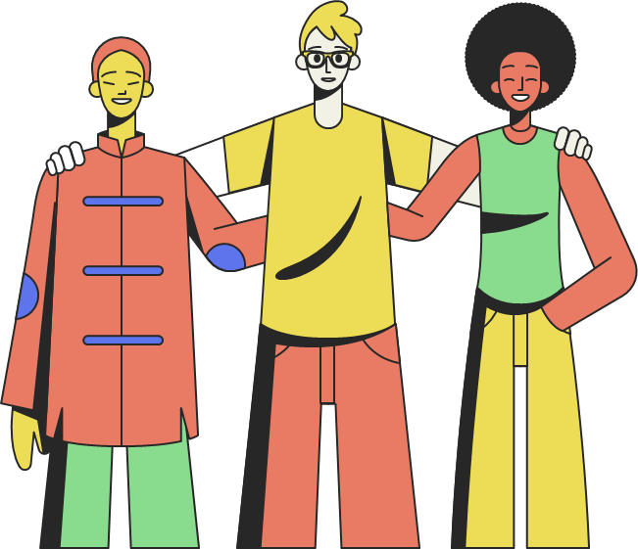
SOCIAL INTERACTION AND SOCIAL STRUCTURE
LECTURE-3
MS.SHAHTAJ SHAKIR AND MS.AQSA FAYYAZ
SOCIOLOGY

Slide 2
LEARNING OUTCOMES
Introduction to social interaction
Five types of social interaction
Social Structure and its elements
Society and types of societies

Slide 3

SOCIAL INTERACTION
Social interactions occur every single day. They involve some form of the communication of information or the expression of some culturally accepted idea between two or more individuals or groups.
The two main methods of communication that are used in social interactions are verbal interactions and non-verbal interactions.
Through symbols, language, gestures or expression of ideas

Slide 4
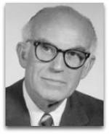
5 types of social interactions
According to Nisbet, there are five key types of social interaction:
Exchange
Competition
Cooperation
Conflict
Coercion.
Robert Alexander Nisbet was an American sociologist, a professor at the University of California,

Slide 5
EXCHANGE
Exchange is a type of social interaction where an individual or a group acts in a certain way toward another individual or group to receive a reward.
The most common type of exchange relationship is between an employer and an employee. The employee has to behave according to the wishes of the employer if they want to receive a reward.
The reward doesn’t need to be monetary or even material. This reward could be as simple as an expression of love, gratitude, or recognition (Nisbet, 1970, p. 56).
Notes:
https://helpfulprofessor.com/social-interaction-types-and-examples/

Slide 6
2. Cooperation
Cooperation is interaction in which individuals or groups act together to promote common interests or achieve common goals.

Slide 7
3. Competition
Competition is a rivalry where two or more parties strive for a common goal which cannot be shared: where one's gain is the other's loss.
People can compete over tangible resources like land, food, and mates, but also over intangible resources, such as social capital. Competition is the opposite of cooperation and arises whenever two parties strive for a goal that cannot be shared.
competition can have both beneficial and detrimental effects. Positively, competition if it follows rules of conduct may serve as a form of recreation or it helps to motivate people to perform the the roles society asks of them. On the negative side, competition can cause injury, psychological stress, inequality, lack of cooperation and even conflict.

Slide 8
4 Conformity
Conformity is all behavior that is in accord with the social norms and values of a given social group.
The most common example of conformity might be in politics. It is common to see an individual stop
believing in something only because the political party they are affiliated with does not approve of that
belief.
A similar process takes place in friend groups, romantic relationships, family relationships, and so on.

Slide 9
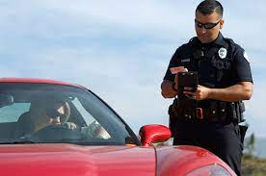
Coercion
Compelling an individual or group—either intellectually, morally, or physically—to do something; using force or threatening to use force.
Boycott is the withholding of social or economic interaction with others to express disapproval and to force acceptance of demands.

Slide 10
SOCIAL STRUCTURE

Slide 11
Social structure
Humans are social beings, we live and work in groups and interact in predictable ways.
Every society has a structure that guides human interaction.
This structure helps people know what is expected of them in most social situations and what they can expect from others.

Slide 12
Social structure
is the very foundation in which human beings organize themselves into both simple and complex groups whose goal is to provide common understanding, community, purpose and security for all of their members.
These groups include but are not limited to: families, schools, religious organizations, social clubs, etc
Allow people the opportunity to be closer to one another and share their mutual thoughts, experiences, and perspectives in order to gain a more complete grasp of the world around them.
Notes:
https://study.com/academy/lesson/what-is-social-structure-of-society-definition-theory-quiz.html

Slide 13
The major components of social structure include culture, social class, social status, roles, groups, and social institutions.
Social structure guides people’s behaviors.
A person’s location in the social structure (his or her social class, social status, the roles he or she plays, and the culture, groups, and social institutions to which he or she belongs) underlies his or her perceptions, attitudes, and behaviors.
Also used in relation to social change.

Slide 14
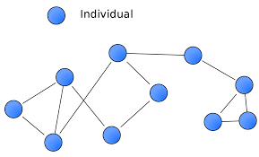
ELEMENTS OF SOCIAL STRUCTURE
Social structure can be broken down into following elements:
Status
Roles
Social networks
Groups
Organizations

Slide 15
STATUS
Each individual in society occupies several statuses.
An individual can be a father, a teacher, a husband, brother an African American all at the same time.
A status set is all of the statuses that a person occupies at any particular time.
Statuses are ways of defining where individuals fit in society and how they relate to others in society.

Slide 16

STATUS
A status is a socially defined position/rank in society characterized by certain expectations, rights and duties.
Types of status:
Ascribed Status: given to individual generally at birth and from which they cannot escape; these statuses are fixed.
Examples: Things like ethnicity, birth order, height, and eye color

Slide 17
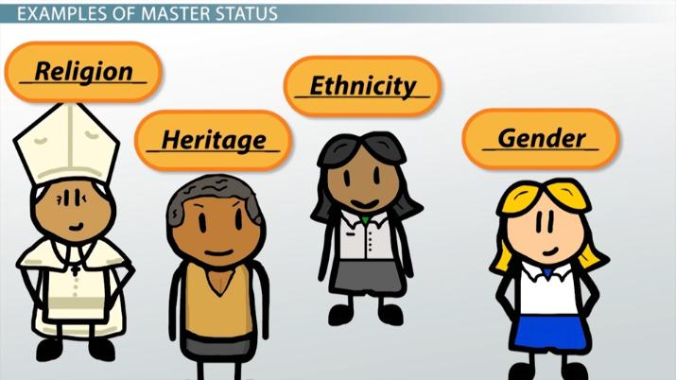
Achieved Status: Positions that are achieved by individuals for themselves ; these status can change.
For example, the statuses of husband, mother, lawyer, doctor, professor, or student are all achieved statuses.
Master status: the most important status that a person occupies. The dominant one or a status which they view as the most important part of their identity. It often determines people’s perceptions of you and your choices in life.
Example: Age, religion, sexual orientation, race, ethnicity, occupation, and socioeconomic status.

Slide 18
Roles of Social Structure
Role are sets of norms that specify the rights and obligations of each status/ the behaviors, obligations, and privileges attached to a status.
Example: I have the status of ‘Teacher’; My role is to teach.

Slide 19
Problems of social structure
Role conflict: A role conflict is when a person is expected to fulfill the duties of two contradictory positions. Faces tension in different roles of different statuses.
Example: In case if a person is both dad and coach. As a father, he wants to see his son participating in the baseball game no matter how good or bad his skills are. As a coach, he has to do what's best for the team. This means he must put in players that are talented and will help the team win the game.

Slide 20
2. Role Strain: occurs when incompatible role demands develop within a single status.
Example: role strain occurs when a person has difficulty meeting the responsibilities of a particular role in his or her life.
Student example: submission of thesis and exams simultaneously
Domestic mother (preparation of breakfast, has to iron uniform)

Slide 21
Social institution
A place where group of people who come together for common purpose.
the organized, usual, or standard ways by which society meets its basic needs
These are the structure of society which fulfills the needs of society.
The family, religion, law, politics, economics, education, science, medicine, and the military all are social institutions.
Social institution operates, maintain and regulate the society.
It is necessary for the survival of society.
It has its rules and roles (example: education system/ school institution)
Exists in every society

Slide 22
The family, religion, law, politics, economics, education, science, medicine, and the military all are social institutions.
In industrialized societies, social institutions tend to be more formal and in nonliterate societies, more informal.
Each institution has its own groups, status, values, and norms.

Slide 23
5 major social institution
Family
Religion
Education
Politics/Government
Economy

Slide 24

1.FAMILY
Primary and universal social institution
The institution of family is a basic unit in the society, and the multifaceted functions performed by it makes it a much-needed institution in a society.
It is considered a "building block" of society because it is the primary unit through which socialization occurs.
Basic unit: marriage
To provide for the rearing of children.
To provide a sense of identity or belonging among its members.
To transmit culture between generations.

Slide 25
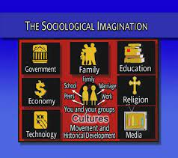
2. education
It is the social institution through which society provides its members with knowledge, including basic facts, job skills, and cultural norms and values.
Responsible for the systematic transmission of knowledge, skills and cultural values within a formally organized structure.
Examples of educational institutes include elementary schools, junior schools, open universities, and vocational training institutes.

Slide 26
3. economy
Production, distribution and consumption of good and services
It regulate the economic needs of society.
It is also responsible for the exchange of money and other resources

Slide 27
4. Politics/ government
Policy makers
Implement Laws
It is responsible for maintaining order, protecting citizens from harm, and providing for the common good.
The government does this through its various sub-institutions and agencies, such as the police, the military, and the courts.
These legal institutions regulate society and prevent crime by enforcing law and policy

Slide 28
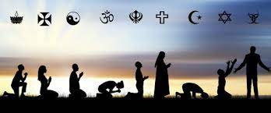
5. religion
It is an organized system of beliefs and practices designed to fill the human need for meaning and purpose (Durkheim, 1915).
Satisfy the spiritual needs of human needs.
It promotes social solidarity, social cohesion and social control.
Religion can be used to instill moral values and socialize individuals into a community. Religion plays a significant role in shaping the way people view themselves and the world around them.
It can provide comfort and security to those in need. Large religions may also provide a basis for community support, establishing institutions of its own such as hospitals and schools.

Slide 29

Social group
People who interact with one another and who believe that what they have in common is significant; also called a social group.
Any number of individuals that share common values, goals and interact on a regular basis.
Our families
our different friendship groups
the sociology class and other courses we attend
our workplaces, the clubs and organizations to which we belong

Slide 30
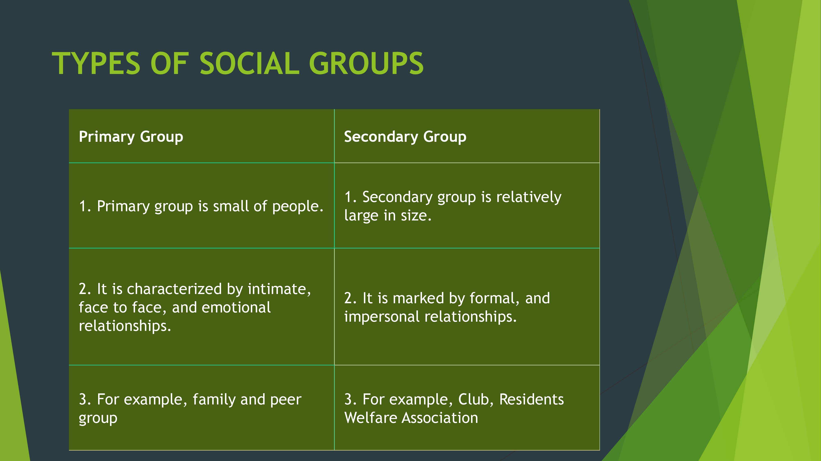

Slide 31
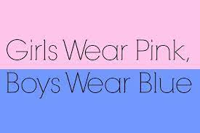
The Social Construction of Reality (Thomas Luckman and Peter L. Berger)
Sociologists generally accept that reality is different for each individual. The term social construction of reality refers to the theory that the way we present ourselves to other people is shaped partly by our interactions with others, as well as by our life experiences.
Pink is for girls, blue is for boys

Slide 32
Dramaturgy
Dramaturgy is a sociological concept developed by Erving Goffman that uses the metaphor of theater to explain human behavior.
Impression Management: the sum total of actions we take — both consciously and unconsciously — to influence how others perceive us.
Front stage self and back stage self
The front stage self encompasses the behavior a player (person) performs in front of an audience (usually society, or some subset of society). A person performs her front stage self when she knows she is being watched and that her behaviors is subject to judgment by an audience.
Example: Working in an institute
Back stage Self: In contrast, we may only let our guard down and fully relax when we're by ourselves or familiar people — here we're back stage.
A useful, and everyday way of understanding dramaturgy (specifically front stage and back stage) is to think of a waiter or waitress at a restaurant. Their main avenue of concern for him or her is "customer service." Even if a customer is rude, waiters and/or waitresses are expected to be polite ("the customer is always right") as part of their job responsibilities. That same waiter or waitress speaks differently when going out to her/his break room. s/he may complain, mimic and discuss with their fellow peers how irritating and rude the customer is. In this example, the waiter/waitress acts a certain way when dealing with customers and acts a completely different way when with her/his fellow employees.
Notes:
https://www.thoughtco.com/goffmans-front-stage-and-back-stage-behavior-4087971#:~:text=The%20routines%20of%20people's%20daily,category%20of%20front%20stage%20behavior.

Slide 33

Video
Notes:
https://www.youtube.com/watch?v=5Qe5TI__ZDU

Slide 34
What is society then?
In sociological terms, society refers to a group of people who live in a definable community and share the same cultural components.
Gerhard Lenski Jr. (1924–2015) defined societies in terms of their technological sophistication.
Sociologist Gerhard Lenski Jr. (1924–2015) defined societies in terms of their technological sophistication. As a society advances, so does its use of technology. Societies with simple technology depend on the fluctuations of their environments, while industrialized societies have more control over the impact of their surroundings and thus develop different cultural features. This distinction is so important that sociologists generally classify societies along a spectrum of their level of industrialization—from preindustrial to industrial to postindustrial.

Slide 35
Types of societies
Preindustrial Societies
Industrial Society
Postindustrial Society

Slide 36

than

